Slide 1
TP Seaborn: Data Analysis
Correlation, Boxplot,
Age Distribution, and Scatterplot
Onickael - Data Scientist INSI

Slide 2
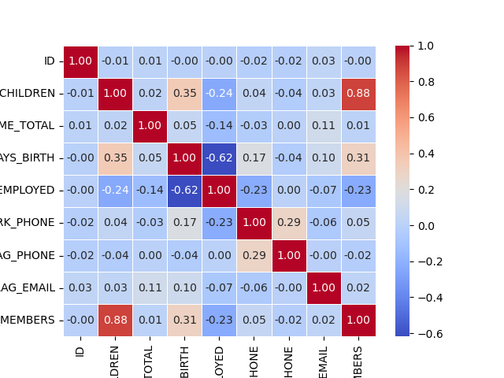
Correlation Heatmap
Correlation Heatmap :
Here, we can see a heatmap that shows the correlation between the various numerical columns in the dataset.
The strongest correlation is between AMT_INCOME_TOTAL and the CNT_CHILDREN with a correlation coefficient of 0.88. This suggests that those who have more children tend to have higher incomes, in other hand, more motivated, hard worker.
We can observe negative correlations between AMT_INCOME_TOTAL and DAYS_BIRTH with a correlation of minus 0.62. This indicates that younger people might have higher total incomes, but the relationship is not strong.
WORK_PHONE and FLAG_OWN_REALTY show relatively weak correlations with other variables, implying these columns are not strongly linked with the total income or other attributes.

Slide 3
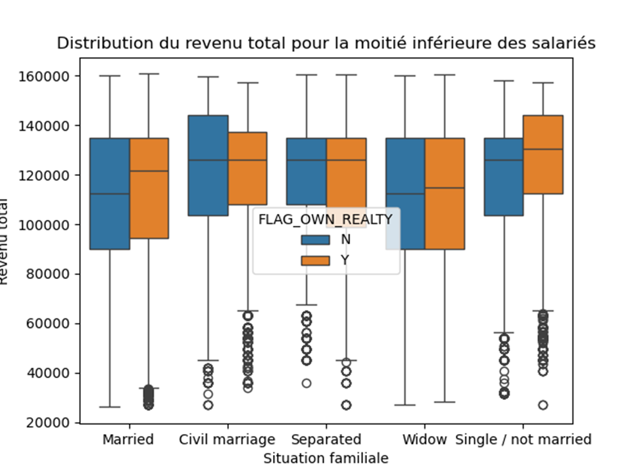
Boxplot of Total Income vs Family Status
Boxplot of Total Income and Family Status
This boxplot shows the distribution of the total income (AMT_INCOME_TOTAL) for each category of family status (NAME_FAMILY_STATUS). Here we have a visual comparison of income distribution, helping identify income disparities across family statuses and real estate ownership.
The plot compares individuals who own real estate (FLAG_OWN_REALTY = Y) versus those who do not (FLAG_OWN_REALTY = N).It appears that people who own real estate (Y) tend to have a slightly higher total income, as shown by the higher median income across the family statuses.
However, there is a significant amount of variation in the income distribution within each family status category, with some outliers (especially in the Widow and Single / not married categories).

Slide 4
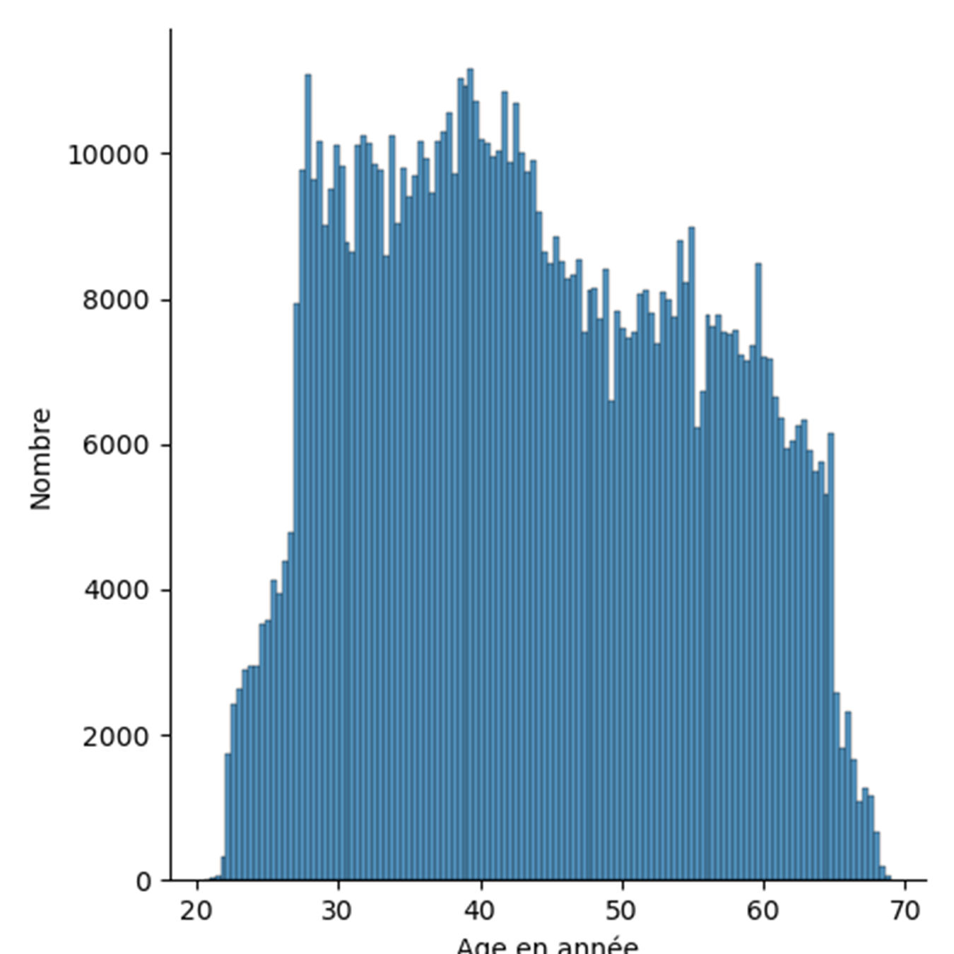
Age Distribution
Age Distribution
The histogram shows the distribution of ages in years, ranging from approximately 20 to 70 years old.
This histogram helps visualize the age demographics of the dataset, showing that most individuals are in the middle age ranges cause the distribution obviously have a larger concentration of individuals in the 30-40 age range, and a noticeable drop-off in the number of individuals as age increases, suggesting a low life expectancy.

Slide 5
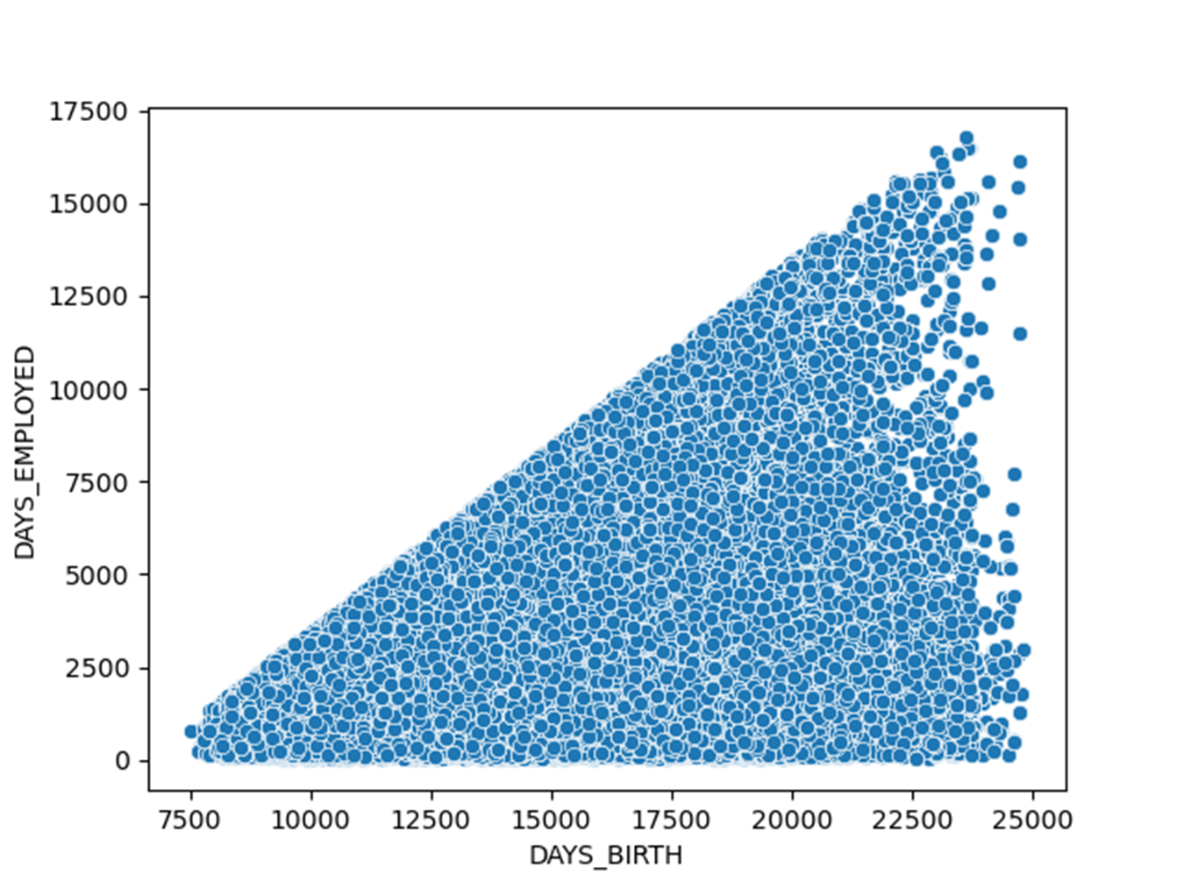
Days Employed and Days Birth
Scatterplot of Days Employed vs Days Birth
The scatterplot represents the relationship between DAYS_BIRTH and DAYS_EMPLOYED.
There is a clear positive relationship, as older individuals tend to have more days of employment.
The scatterplot also reveals a cluster of individuals with a relatively low amount of employment (DAYS_EMPLOYED) for their age, suggesting the presence of some individuals with irregular periods of unemployment.

